Slide 1

Sales Analysis
By - Prince Raj (S6783)

Slide 2
Purpose of The Capstone Project
The major aim of this project is to gain insight into the sales data of Amazon to understand the different factors that affect sales of the different branches.
The dataset used contains sales transactions from three different branches of Amazon, respectively located in Mandalay, Yangon and Naypyitaw.

Slide 3
Product Analysis
Product Line Performance: Food and beverages are the top performing product line, generating the highest revenue. This indicates a strong demand for these products.
Underperforming Product Lines: Health and beauty products seem to be underperforming compared to others. This suggests a need for further analysis into the reasons behind their lower sales.
VAT Incurred: Food and beverages also incurred the highest VAT, which could be indicative of their higher sales volume or pricing.

Slide 4
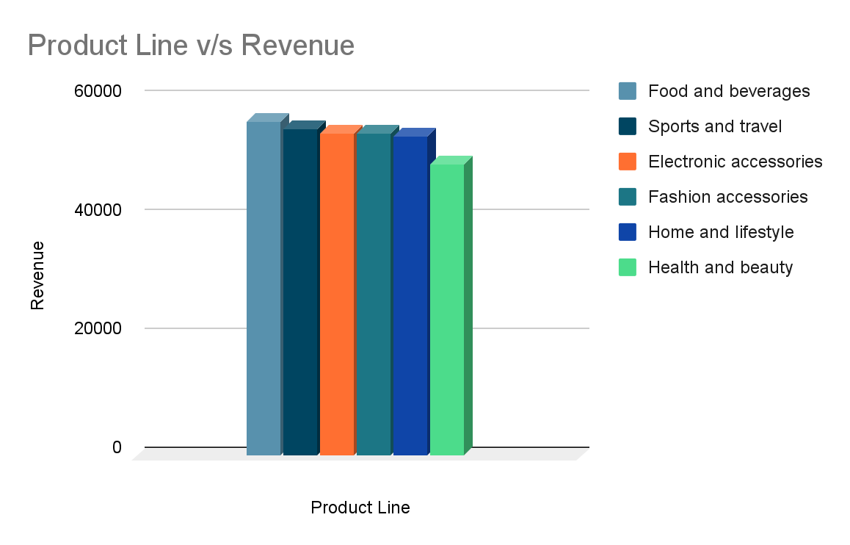

Slide 5
Sales Analysis
Revenue by Month: January had the highest revenue, followed by March and February. This indicates potential seasonal trends or promotional activities during these months.
Time of Day Sales: Afternoon consistently sees the highest number of sales across weekdays. This suggests that promotions or marketing efforts during this time could yield better results.
Branch Performance: Branch C exceeded the average number of products sold, indicating potentially better sales strategies or customer engagement at that branch.

Slide 6
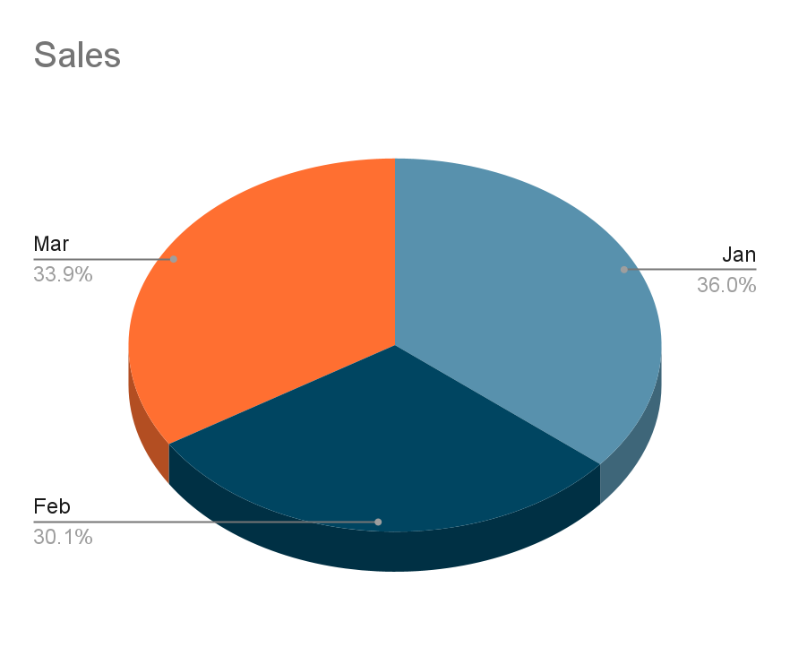
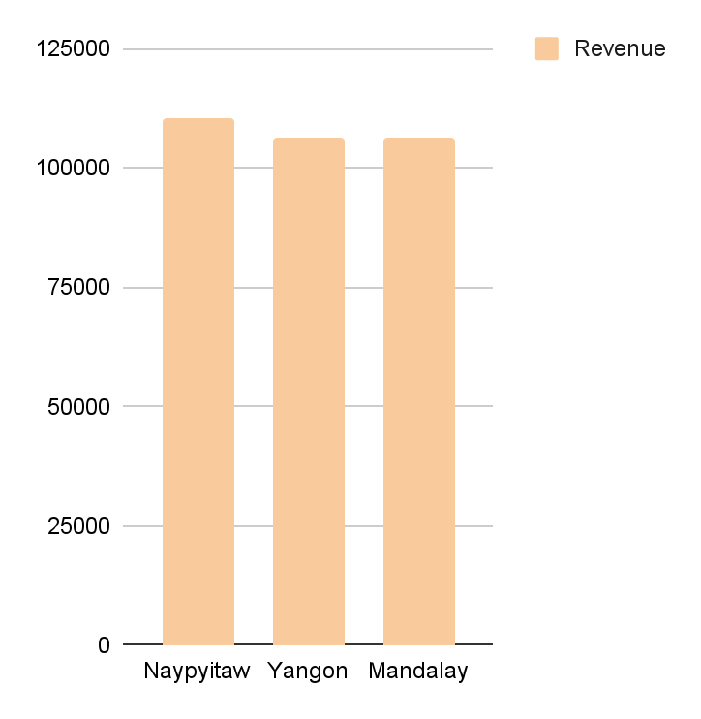

Slide 7
Customer Analysis
Customer Types: Member-type customers contribute the highest revenue and make the most frequent purchases. This suggests the importance of loyalty programs or incentives to retain and attract such customers.
Gender Distribution: Women are predominant among customers, which could inform marketing strategies and product offerings catering to this demographic.
Purchase Trends: Fashion accessories are frequently associated with female customers, while health and beauty products are associated with males. This insight can help tailor marketing and product placement strategies accordingly.

Slide 8
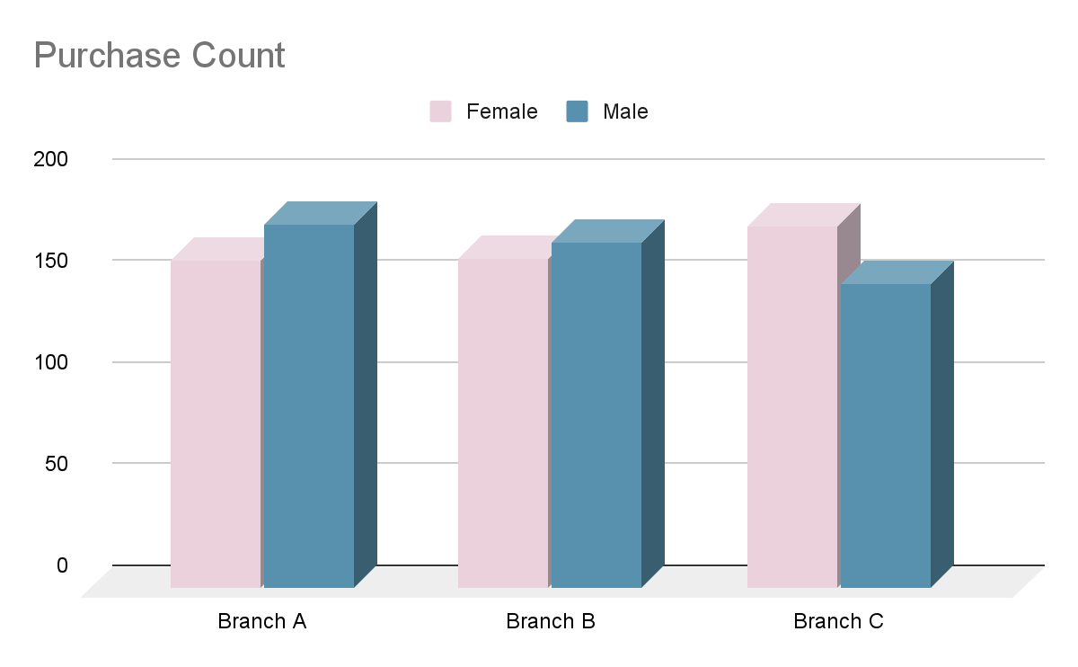

Slide 9
Recommendations
Product Line Improvement: Further analysis into the underperforming product lines, such as health and beauty, could help identify areas for improvement. This might involve adjusting pricing, promotions, or product offerings to better meet customer needs.
Sales Strategy Refinement: Utilize insights from sales trends by month, time of day, and branch performance to refine sales strategies. This could involve targeted promotions, adjusting staffing levels, or optimizing inventory management.
Customer Segmentation: Develop targeted marketing campaigns and loyalty programs based on customer segments. This could include personalized offers, rewards, or exclusive access to products/events to different customer types.

Slide 10
Conclusion
In conclusion, the analysis conducted on the dataset provides insights into product performance, sales trends, and customer behavior. Food and beverages are the top-performing product line, with significant revenue, while health and beauty product line need improvement. Sales analysis reveals patterns such as higher revenue in certain months and peak sales during the afternoon. Additionally, customer analysis highlights the importance of member-type customers and the predominance of female customers. These insights can help in optimizing product offerings, refining sales strategies, and enhancing customer engagement to drive business growth and profitability.

Slide 11


